Slide 1
Flaky Tests at Google and How We Mitigate Them
Patrick, Jacob, Brian, Nathan, Mehak, Ethan
Notes:
(delete this link before presentation: Source: https://testing.googleblog.com/2016/05/flaky-tests-at-google-and-how-we.html)

Slide 2
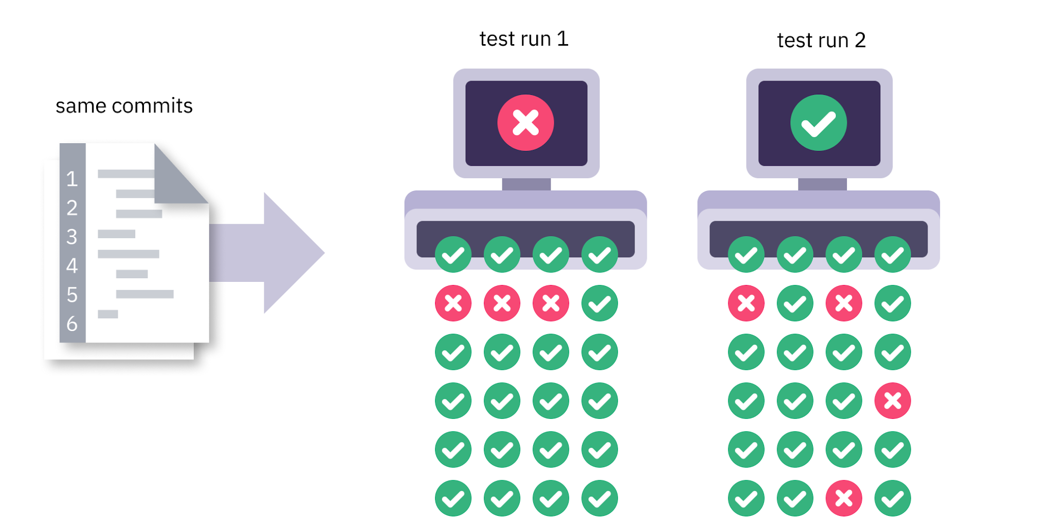
What are flaky tests?
Google defines a "flaky" test as test that exhibit both a passing and a failing result with the same code
At Google 1.5% of test are reported as a “flaky” test and about 16% of test have some level of “flakiness”
https://cdn.spark.app/media/launchable/image/flaky_tests_2_.png
Notes:
Reported -> Usually projects have an average of 1000 tests, and this means that 15 tests will likely fail before release.
Some level of flakiness -> This is somewhat equivalent to 1 in every 7 tests written.

Slide 3
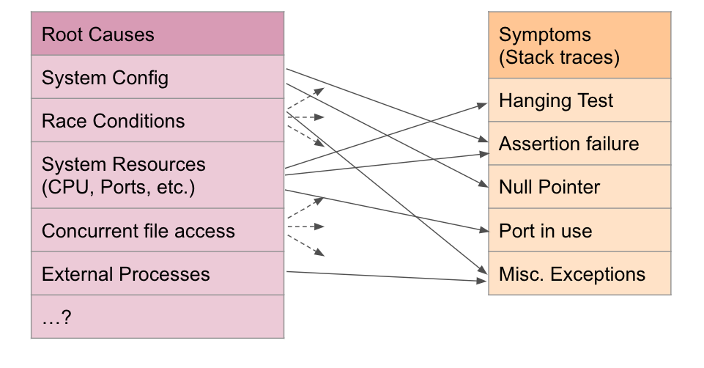
Common Causes
Concurrency
Non-deterministic or undefined behaviors
Flaky third party code
Infrastructure problems
https://1fykyq3mdn5r21tpna3wkdyi-wpengine.netdna-ssl.com/wp-content/uploads/2021/06/Screen-Shot-2021-01-11-at-3.07.37-PM.png

Slide 4

Consequences
Extra time and effort is needed to review test that change from passing to failing
This work is also repetitive meaning the test usually have to be reviewed multiple times
Legitimate failures that flaky test report are often ignored which results in issues down the road
Test have to be run multiple times which increases the amount of time it takes to find and fix legitimate failures
https://engineering.gusto.com/eliminating-flaky-ruby-tests/

Slide 5


Other Companies
This issue with flaky tests are a widespread issue, not just at Google
Companies such as Uber, and Spotify have created blog posts detailing their experiences with flaky tests
https://newsroom.spotify.com/media-kit/logo-and-brand-assets/
https://techcrunch.com/2018/09/12/uber-is-getting-a-new-look/

Slide 6
Uber
Separate pipeline for flaky tests
If a test is run multiple times and passes once and fails more than once, consider it flaky and it gets moved into the flaky test pipeline
By default, flaky tests are ignored and not used when testing new code is being merged
Try to identify what causes the tests to be flaky
When a test is determined to be flaky, run automated tools to determine if a port collision is causing the flaky test
Have a “fix it week”
Encourage teams with the highest levels of flaky tests to work on their tests
Static code analysis
https://eng.uber.com/handling-flaky-tests-java/

Slide 7
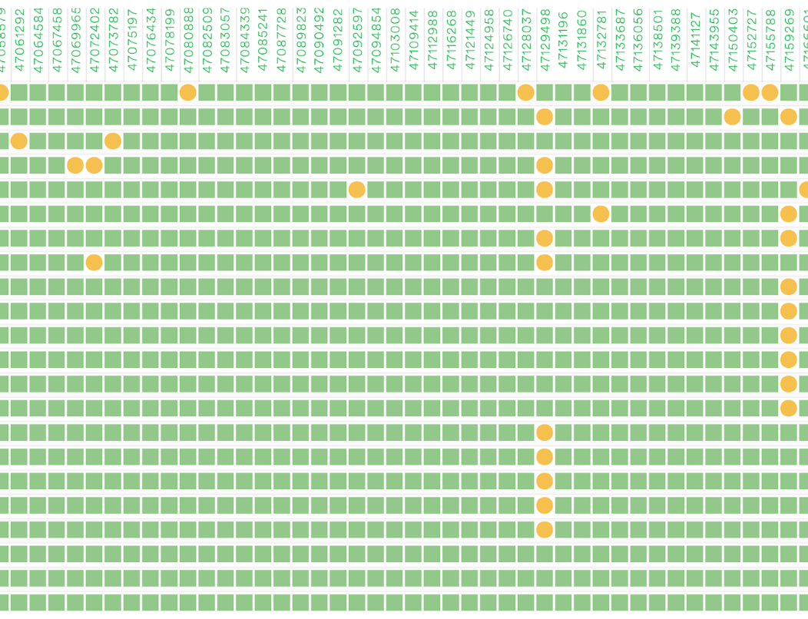
Spotify
Test result visualization with Odeneye
Table that shows developers the time each test takes, and how flaky it is, which helped reduce test flakiness from 6%-4%
Created a git bot that developers could use to run a flaky test multiple times to make sure that the test is no longer flaky once they have fixed it
https://engineering.atspotify.com/2019/11/test-flakiness-methods-for-identifying-and-dealing-with-flaky-tests/

Slide 8
Mitigation Strategies
The ability to only re-run test that fail and to only report an issue if a test fails 3 times in a row
A tool that monitors flakiness and quarantines test when the flakiness becomes too high
A tool that monitors changes in flakiness levels of test and tries to find the cause of the change
A team dedicated to providing accurate and timely information about test flakiness

Slide 9
How can programmers avoid writing flaky tests in the first place?

